Slide 1



Webinar On
Centering Your Customer in Content
Speaker
Mysti Berry
Technical Writer
CrowdStrike

Slide 2

You may be wondering
What does Mysti know about this topic?
30+ years as a technical writer for companies as diverse as Salesforce and 20th Century Fox
Award-winning (unproduced) screenwriter
Award-winning writer and publisher of short crime fiction
Linguistics degree from UC Santa Cruz, a top-five program
I put together insights from all three areas to improve my tech doc.

Slide 3
Centering Your User?
We’re all enthused customer advocates…isn’t that enough?
Using narrative point of view can keep your customer feeling like they are the center of any process they read about. This can reduce cognitive dissonance and reinforce your company’s “customer-first” orientation.

Slide 4
Overview
Center your customer throughout your content:
Point of view briefly explained
Word choice and sentence structure
Workflow diagrams
Structure

Slide 5
POV: an example
John glanced down at his phone. Where r u? floated on the screen. Couldn’t that woman leave him alone? Stacy was his wife, not his parole officer. Stacy didn’t think so, and she waited with phone in hand, anxious for John to text her back. Why hadn’t he answered?
Why is this a little hard to read?

Slide 6
Point of view shift
John glanced down at his phone. Where r u? floated on the screen. Couldn’t that woman leave him alone? Stacy was his wife, not his parole officer. Stacy didn’t think so, and she waited with phone in hand, anxious for John to text her back. Why hadn’t he answered?
Shifting point of view is disorienting.

Slide 7
Point of view in one slide
Narrative point of view:
Person:
  first (I am alive!)
  second (You are alive!)
  third (They are alive!)
Number: singular or plural
Closeness: how close the narrator is to the POV person:
Hemingway vs. Elmore Leonard
Time: present, past, future

Slide 8
Fiction vs. Tech Doc
Person
  Fiction: all of them, sometimes mixed
  Tech doc: almost always second person (tasks) or third person (concepts, reference)
Closeness:
  Fiction: close to distant in third person, typically close in first and second (exception for unreliable narrator)
  Tech doc: distant 99% of the time
Number: Usually singular for fiction & tech doc
Time: present, past, future
  Fiction: all the times
  Tech doc: mostly present tense with brief exceptions for past

Slide 9
Which Person? Where is the customer?
Oracle is the world’s most popular database.
With ODP.NET, Managed and Unmanaged Drivers can be deployed easily to common hosted and third-party cloud environments through Web deploy.
This article provides links to download the Microsoft Build of OpenJDK.
Notes:
In English, the grammatical subject of the sentence is the center. Where is the user in these sentences? Can we easily and concisely add them?

Slide 10
What would center the user?
Oracle is the world’s most popular database. Use Oracle, the world’s most popular database…
With ODP.NET, you can easily deploy Managed and Unmanaged Drivers can be deployed easily to common hosted and third-party cloud environments through Web deploy.
This article provides links to Download the Microsoft Build of OpenJDK.
Notes:
In English, the grammatical subject of the sentence is the center.
Imperative has an implied subject “you.”

Slide 11
Summary: POV and word choice guidelines
Use “you” instead of “us” as the subject, or the imperative (the implied “you”)
Avoid self-reflexive text
Make the customer the subject of the sentence whenever possible.
  Reference content offers fewer chances to do this.
  Concision and friendliness are sometimes at odds.

Slide 12
Centering with workflow diagrams
We often start a workflow with the first thing that happens. That choice doesn’t always center the user.
Left vs. right matters (for English readers).
Describe the workflow in terms of the customer’s job to be done.

Slide 13
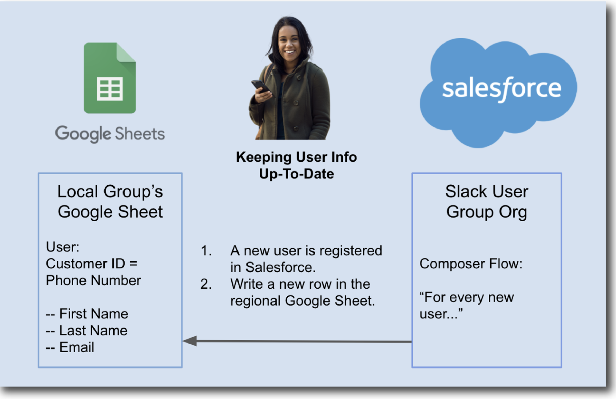
Bad example: workflow

Slide 14
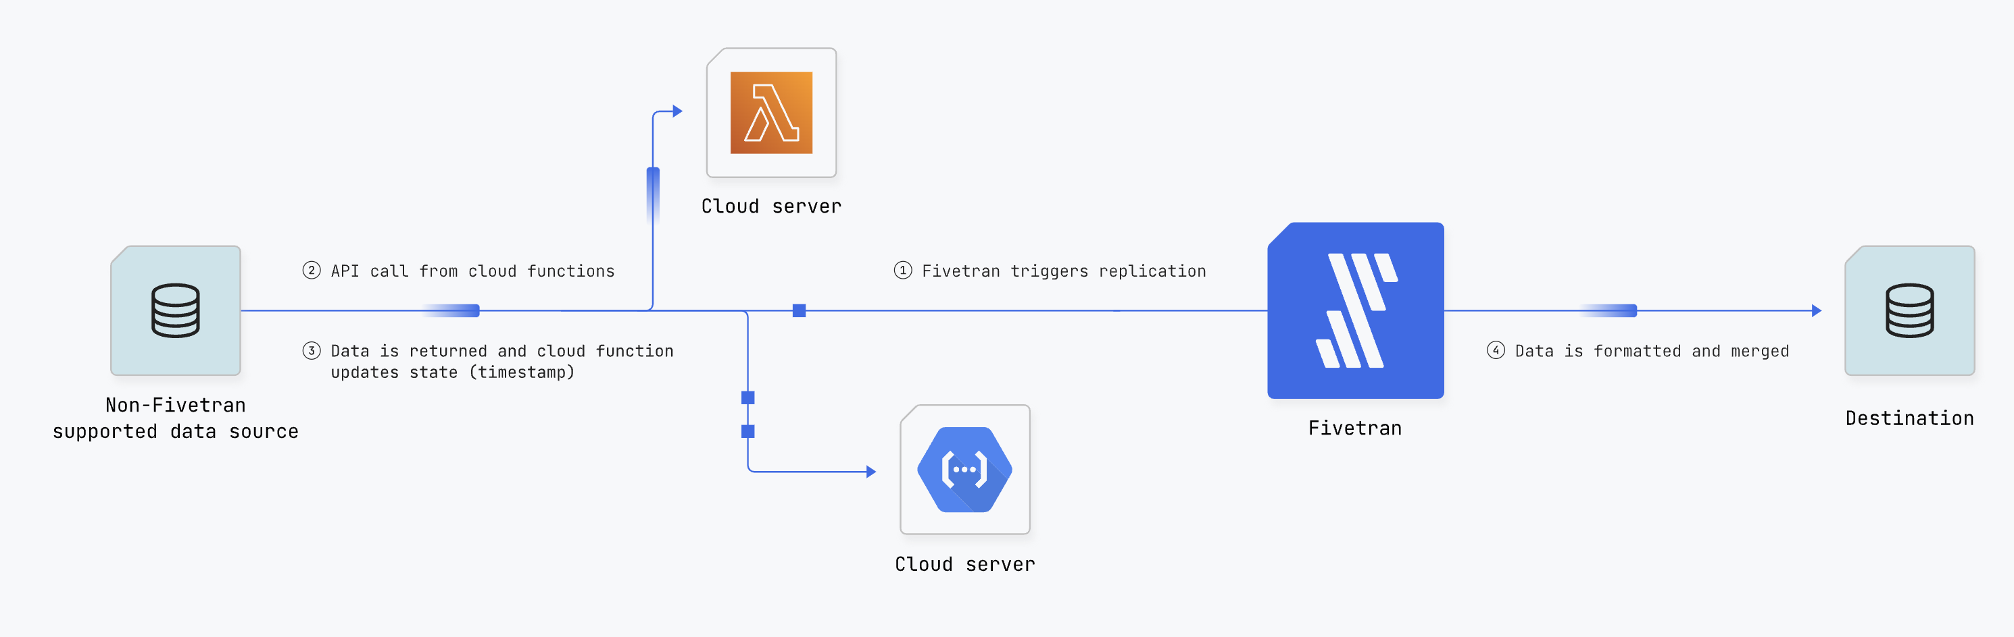
Good example: workflow
Notes:
Starts on the left (for English-speaking audience) with the customer (their data). The company providing the service is easy to spot, but isn’t the starting point.
The diagram explains what happens to the customer’s resource at every step.

Slide 15
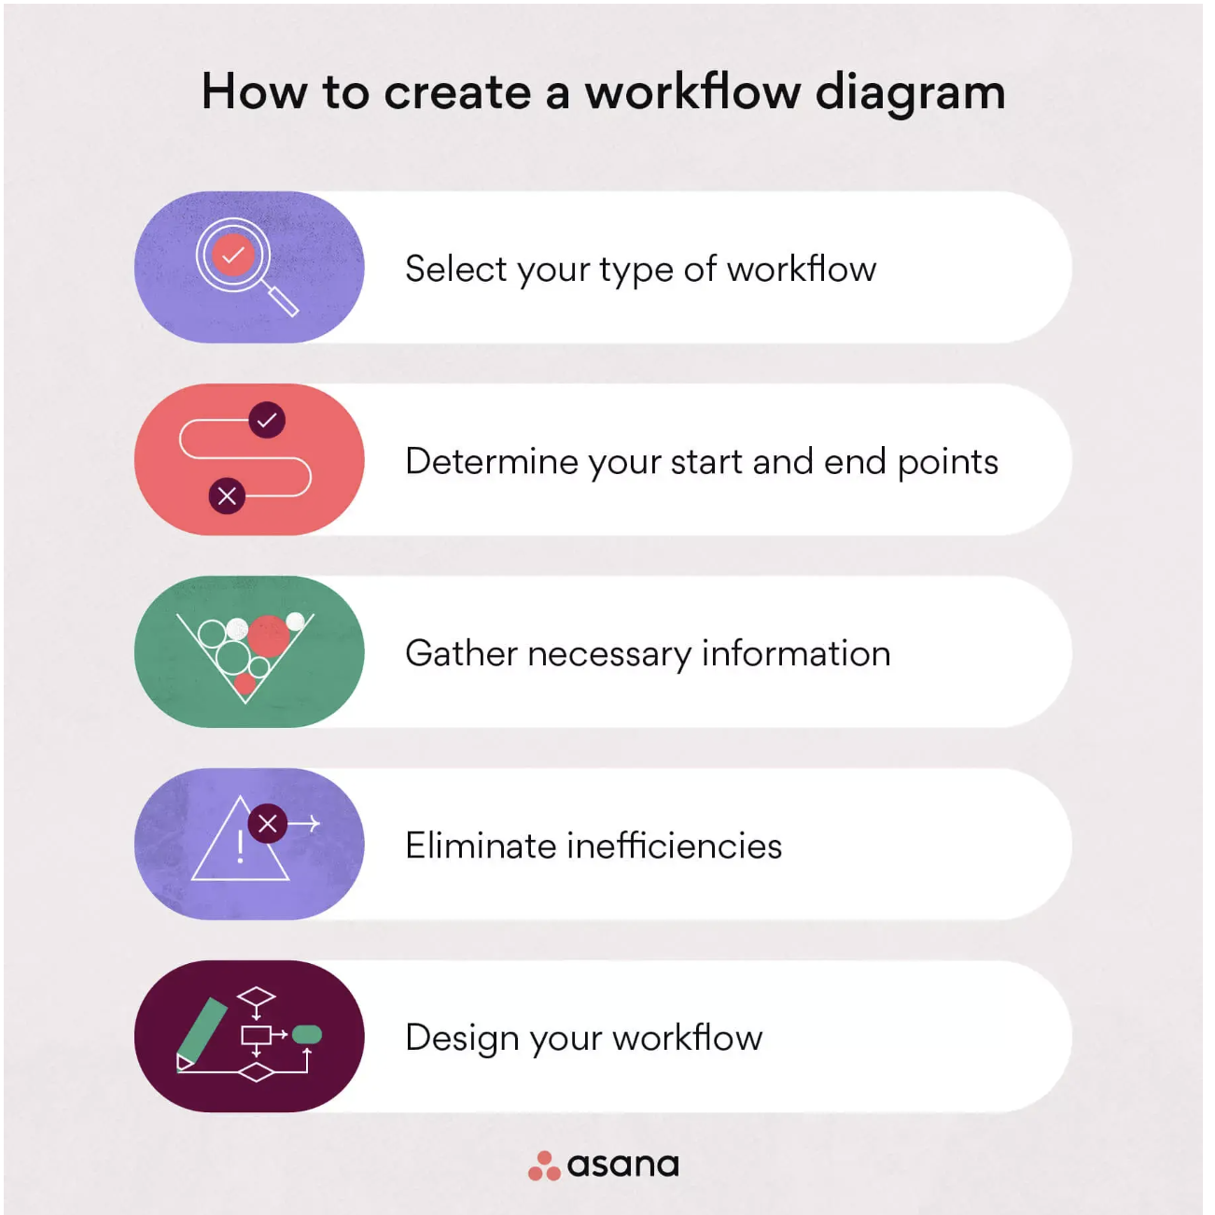
Better example: workflow
Notes:
Every step in the workflow is a task that centers the customer!

Slide 16
Summary: workflow guidelines
Start the workflow from the customer’s “desk” (their cloud or instance or data store…)
Describe the workflow in terms of the customer’s job to be done.

Slide 17
Centering with structure
Personas are a good start. Many companies get by with dev/admin/end user, some companies get more granular.
Consider the jobs to be done when structuring content.

Slide 18
Does structure even matter?
Your customers are likely first accessing your content from a search engine (or an AI bot?).
However, if they can’t find exactly what they are looking for on the first result they click, they are likely to do some hunting and pecking (information foraging).
If your search isn’t great, the hunting and pecking is much more likely.

Slide 19
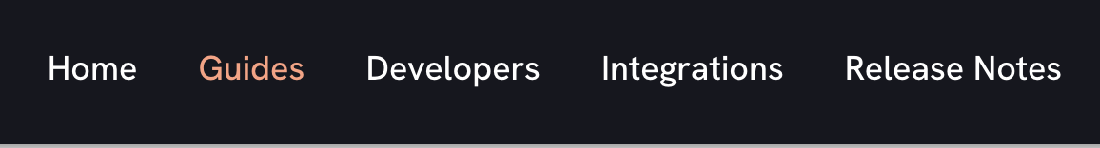
Less helpful example: structure
Mixed taxonomy: content deliverable vs. persona vs. task vs. content type
Where’s the customer?

Slide 20
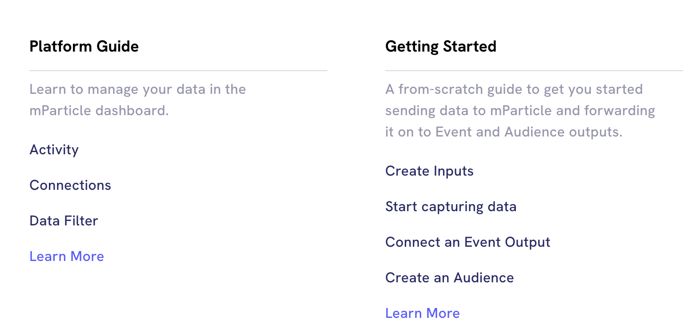
Halfway there…
Titles on the left are product and feature names
Titles on the right are close to customer goals…

Slide 21
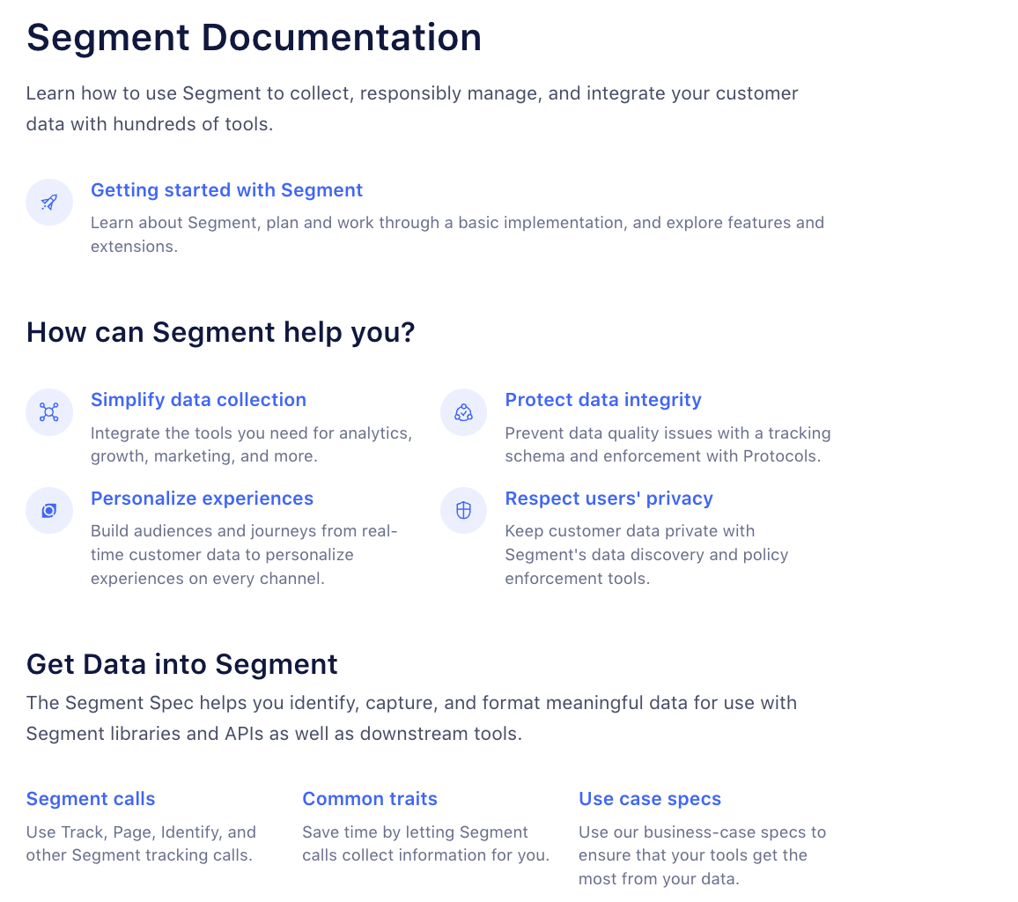
Mostly there!
Customer’s job to be done in the headings.
Customer is literally referenced or implicitly referenced
Notes:
If you go to the site, http://segment.com/docs, you’ll see the product-name list on the left. Teams often create landing pages to correct deficiencies in their overall content structure in lieu of fixing the structure.

Slide 22
Structure summary
Structure content from the customer’s point of view, for example ”jobs to be done” or known user goals. Lead them through the product, don’t itemize the product’s architecture.
Keep the top-level nodes within a single taxonomy: content type (most common, perhaps least useful), user goal, persona.
The organization will often resist structure changes—some feel a perceived loss of importance if their group’s product name isn’t in the top level. Best way to fight this—invite them to navigate through a customer goal using only the product doc.

Slide 23
Overall summary of things you can do
Create a style guide that recommends customer-centric standards
  Use imperatives
  Get rid of self-referential text
  Customer-centric vocabulary
Create workflows that start on the left and with the customer’s data or machines (even if the timeline is different)
Structure your content around “jobs to be done” or the customer’s path through the product, or create landing pages that provide this information.

Slide 24
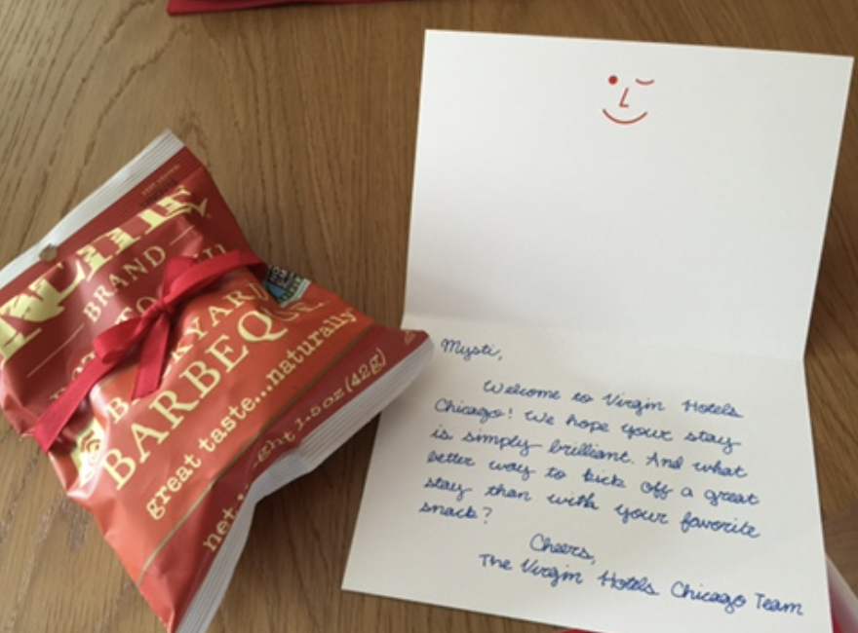
At the end of the day…
We hope our customers spend as little time in the product doc, and as much time being successful, as possible.

Slide 25
Resources
These slides are available at mystiberry.com/secret-pov so you can download and follow the links.
Future tense examples
Information foraging and the scent of information
Example of a great landing page with the same old “shipping our org chart” table of contents.
Content architecture primer
Jobs to be done primer

Slide 26
Questions ?

Slide 27
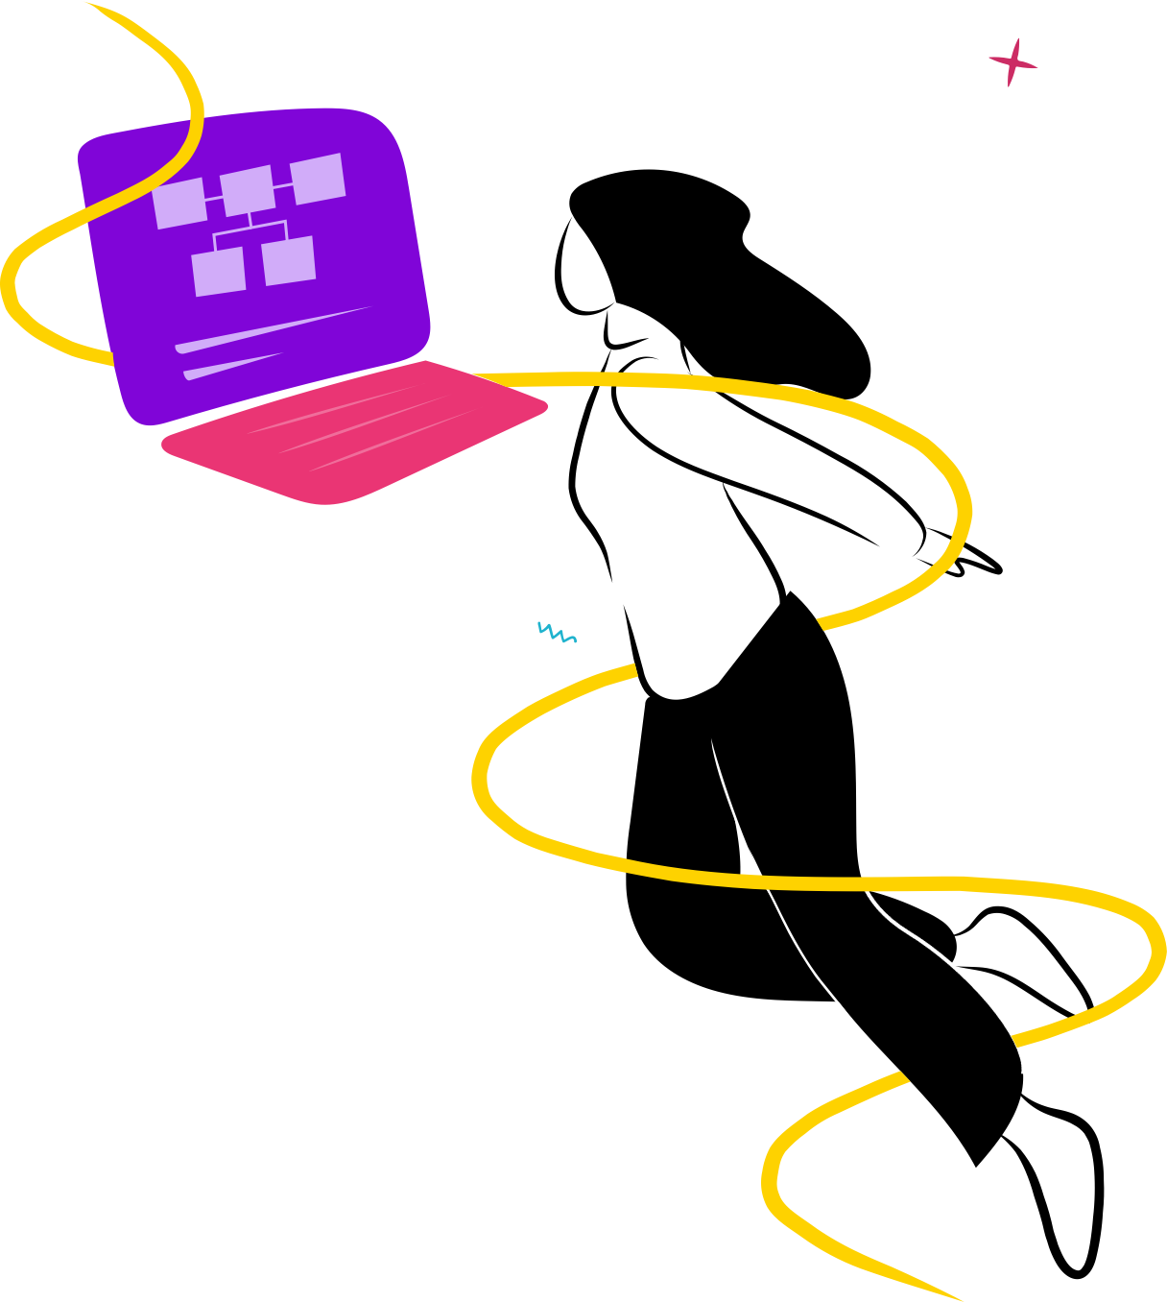

Thank You!

